Slide 1
Movement in a full and dynamic environment using a limited influence map
Paulo Lafeta Ferreira
Artificial Intelligence for Games – CS 580
Professor: Steve Rabin

Slide 2
Introduction: Influence Maps
Most often used in strategy games, but also useful for many other types of games that require an aspect of tactical analysis
Usually too expensive to compute the entire map in one frame

Slide 3
Introduction: Influence Maps
If AI needs to analyze large portions, it may recompute the entire map on a regular basis, like every 1-10 secs.
  Ok in most strategy games, but probably not in fast action games.
Possible solution: limit evaluation of influence mapping to only nearby tiles

Slide 4
Influence Maps
Calculating only the 8 tiles around the player improves performance.
But loses a more general tactical vision, like “frontier” between players, area where its enemies are most likely to attack in the future, etc.
Game developer needs to balance what is most important to his game.

Slide 5
Objective
Create movement with tactical perspective of the current game state using influence mapping
Influence map issue on a fast and full environment: calculate only the tiles around the player AI.
  Some types of games don’t necessarily need all the influence map.

Slide 6
Algorithm: object weights
Each object returns its weight based on its features and player AI’s.
For example, if player already has an item, item weight is zero, else is a positive value.
Bad objects have negative values if they are a threat or positive if they are weak (and then player AI may want to attack it).

Slide 7
Algorithm
Influence map as a 2D grid superimposed on game world
Each player updates his influence map for its own assets
On each tile around the player AI:
  For every object in the world that influences:
    Sum object’s weight / distance
Choose the best tile around and move in its direction.

Slide 8
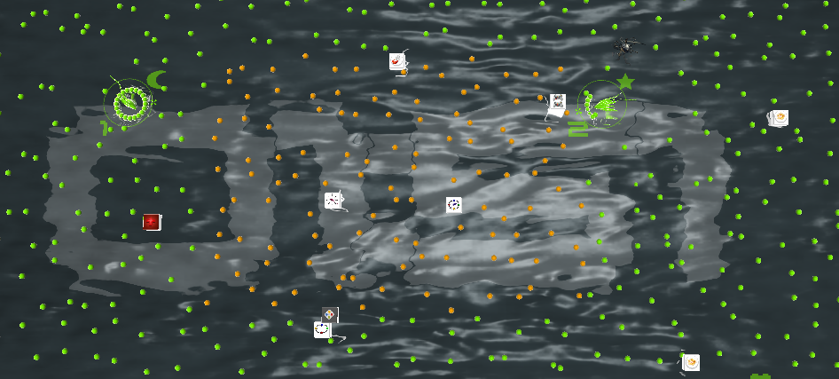
Algorithm
What if we have a lot of objects of same type?

Slide 9
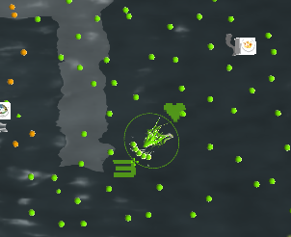
Algorithm
We have too many little balls. We should not evaluate all of them.
So we evaluate only the little balls nearby. Doing a search like “Breadth-first search” algorithm with limited depth.

Slide 10
Demo

Slide 11
Questions?

